Slide 1
How Notifications Influence Screen Time Behavior
Dogukan dogan 31053

Slide 2
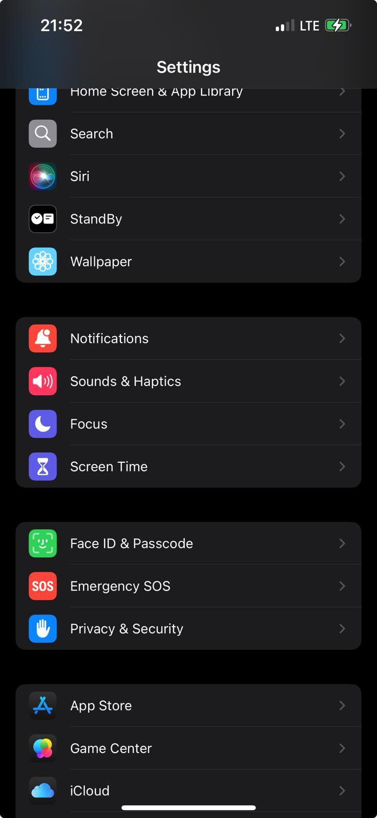
My Data Set

Slide 3
My Hypothesis
Screen time is directly proportional to the number of notifications

Slide 4

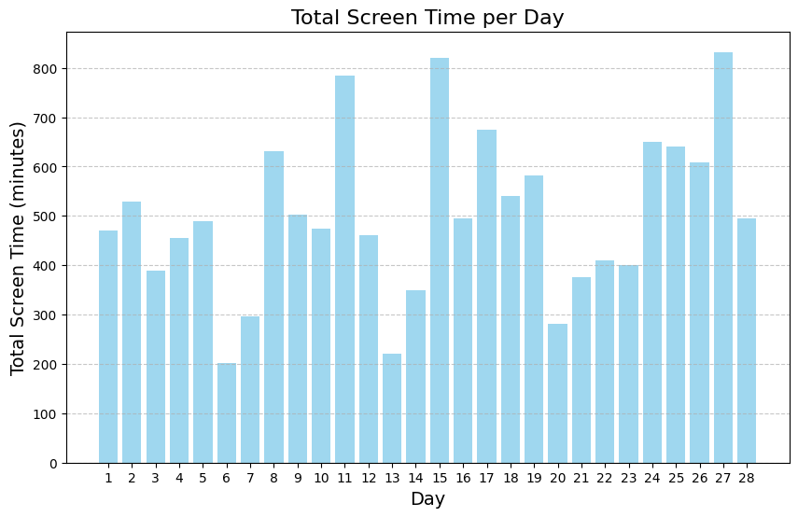
First, I created a plot to visualize my total daily screen time across the entire month.

Slide 5
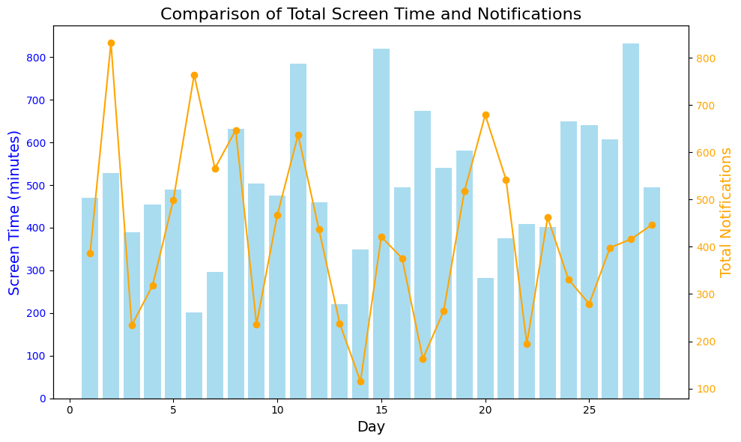
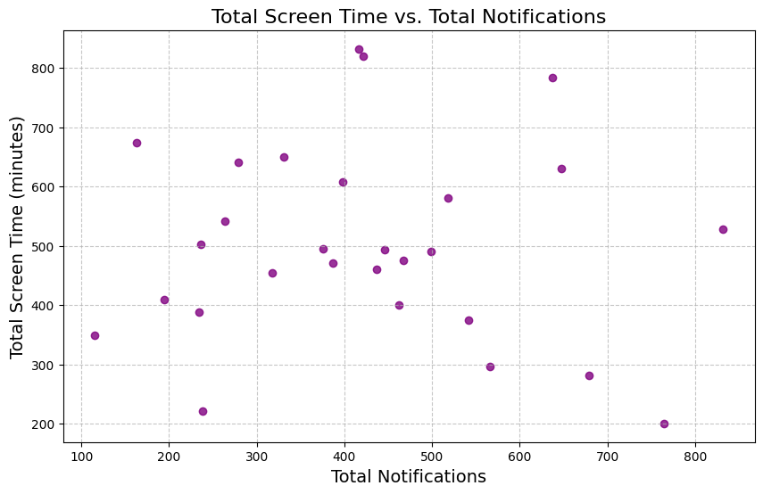
We observe that on some days, my screen time increased, while on others, it decreased. To compare the number of notifications and screen time, I created two charts."

Slide 6
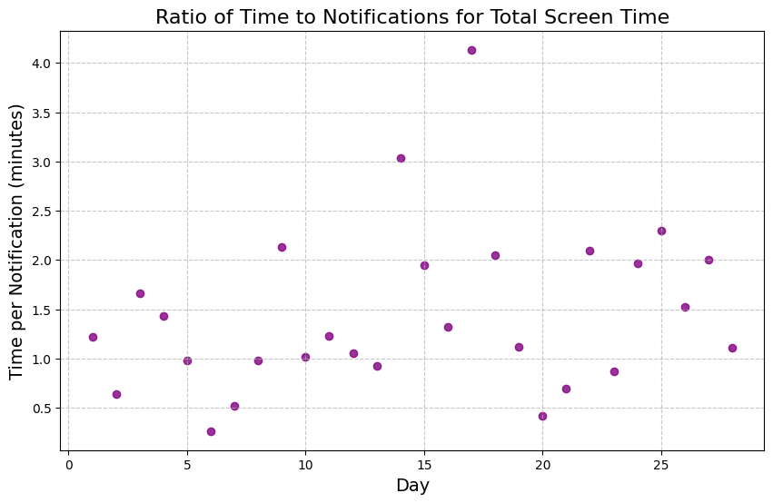
Next, I calculated the average time spent per notification

Slide 7
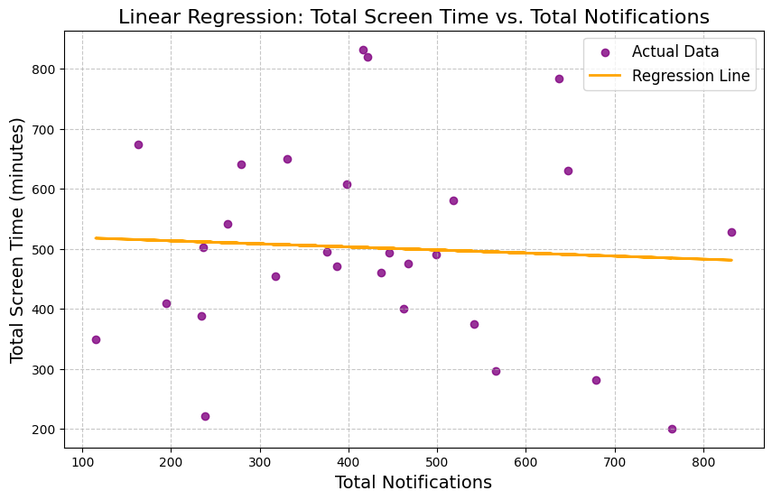
I then analyzed the correlation using linear regression. The results show a weak relationship, with a very low R² value.

Slide 8
Conclusion: Surprisingly, there is no significant correlation between the number of notifications and screen time.

Slide 9
Thank you for your time.

